Slide 1
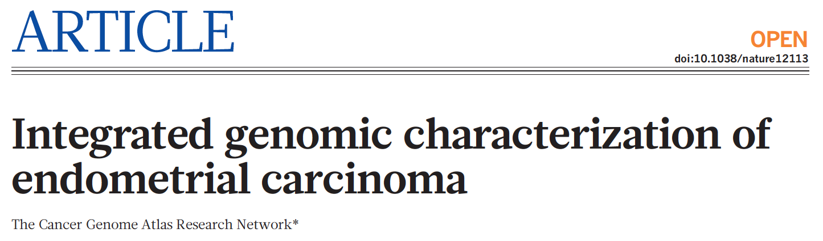

Slide 2

7
Paper
84
Suppl. information

Slide 3
About endometrial tumors
4th common malignancy among women is the US.
estimation: 49,500 new cases and 8,200 death in 2013
Classification:
- type I + grades: endometrioid tumors, early stage, oestrogen excess, obesity
good prognosis.
- type II + grades: serous tumors, older non obese women
worse prognosis (progress < 1year).
Adjuvant therapies:
- type I early stages: radiotherapy
- type II serous: chemotherapy
Molecular alterations:
- type I: mutations in PTEN, PI(3)K/AKT pathway, FGFR2, ARID1A, CTNNB1, PIK3CA, PIK3R1 and KRAS. MSI in 1/3 of cases.
- type II: mutations in TP53, PIK3CA and PPP2R1A

Slide 4
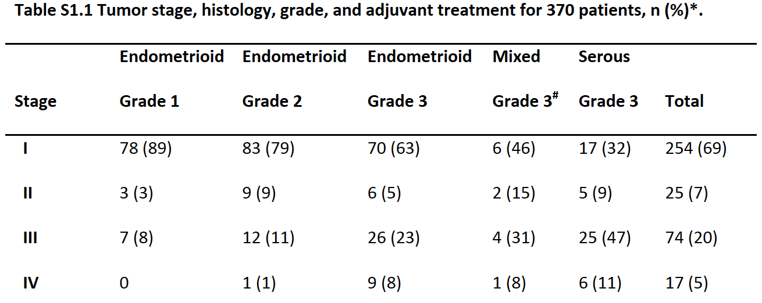
Cohort
304 (82%)
13 (4%)
53 (14%)

Slide 5
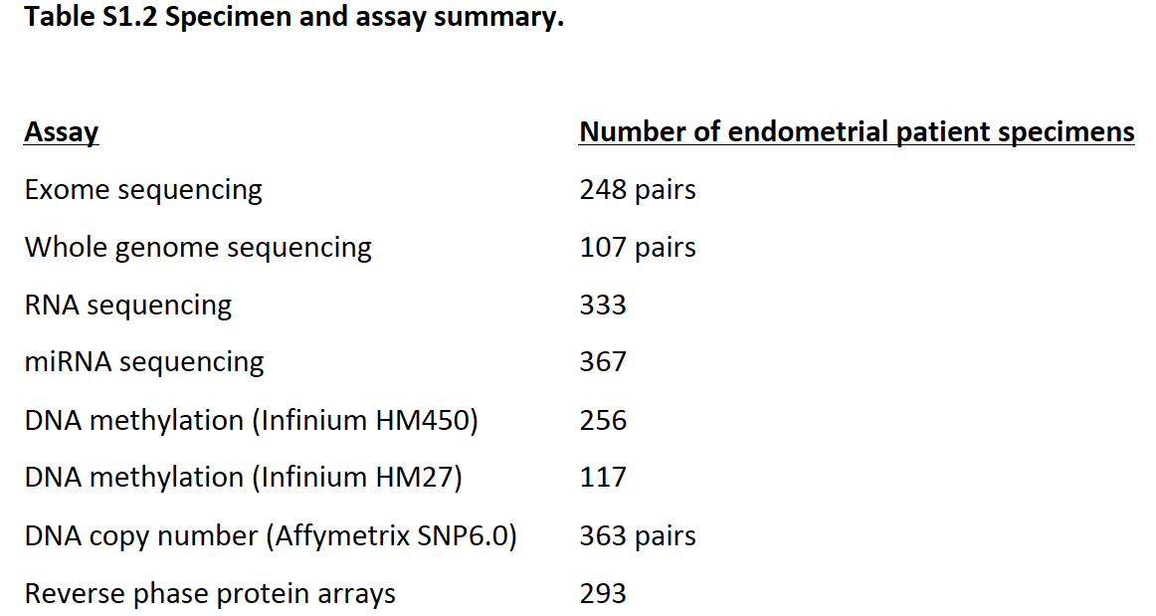
Platforms
+ Micro satellites instability 373

Slide 6
Strategy
Original data
Clusters I - definition using CNV
Super Cluster
Grouping II
CNV-clusters + mutations/MSI/methylation
Clusters III
Global integration
using MEMo
Unsupervised Gene exprs.
Relations with
clusters I & grouping II
Supervised (grouping II)
Gene exprs. & proteins
Potentially molecular-based classification
Potentially molecular-based therapeutic decision
PARADIGM
clusters

Slide 7
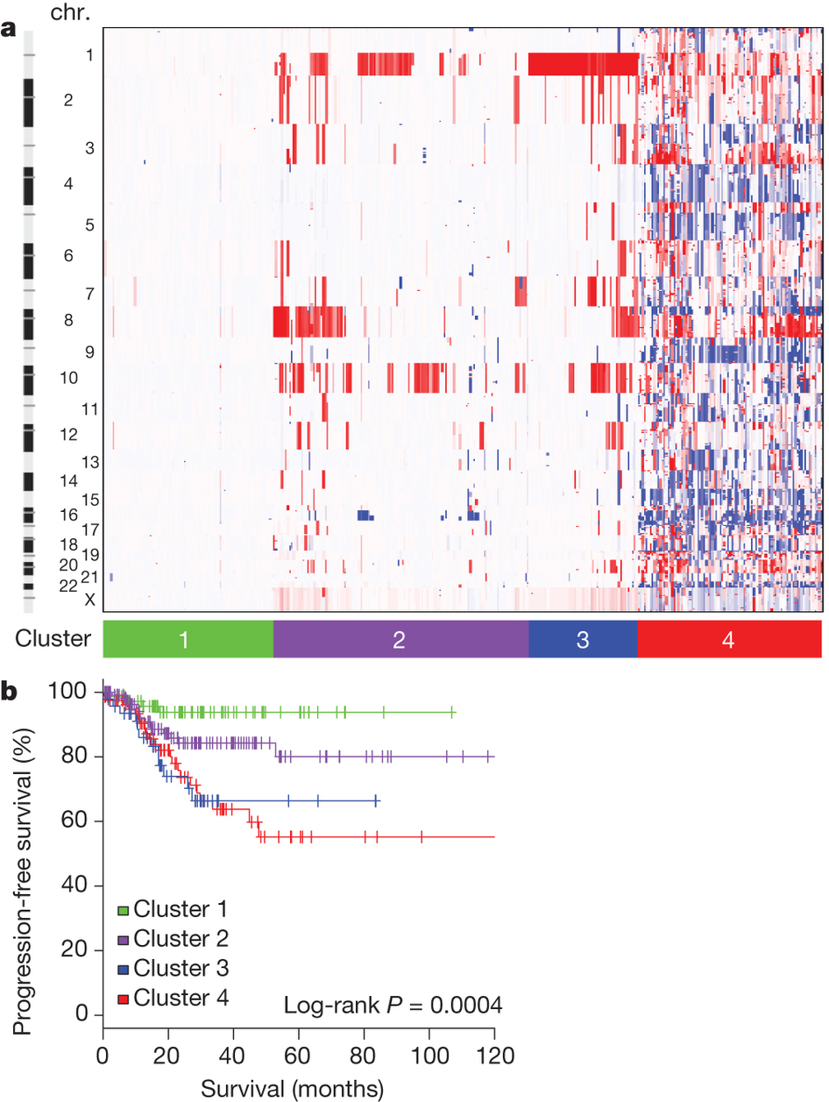
CNV-based clustering
363 samples
SNP6 - GISTIC
<0.5%
Serous (50 of 58)
Mixed (8 of 13)
Endom. (36 of 289)
endometrioid tumors: 97%

Slide 8
CNV-based clustering: survival
Increased PFS associated with low CN alterations (p = 4e-4).
Cluster 3 distinct from cluster 2 on 1q gain frequency
Potentially molecular-driven therapies:
- cluster 2 IGF1R focal amplification
- cluster 4 ERBB2, FGF1, FGFR3 amplifications
LRP1B deletion

Slide 9
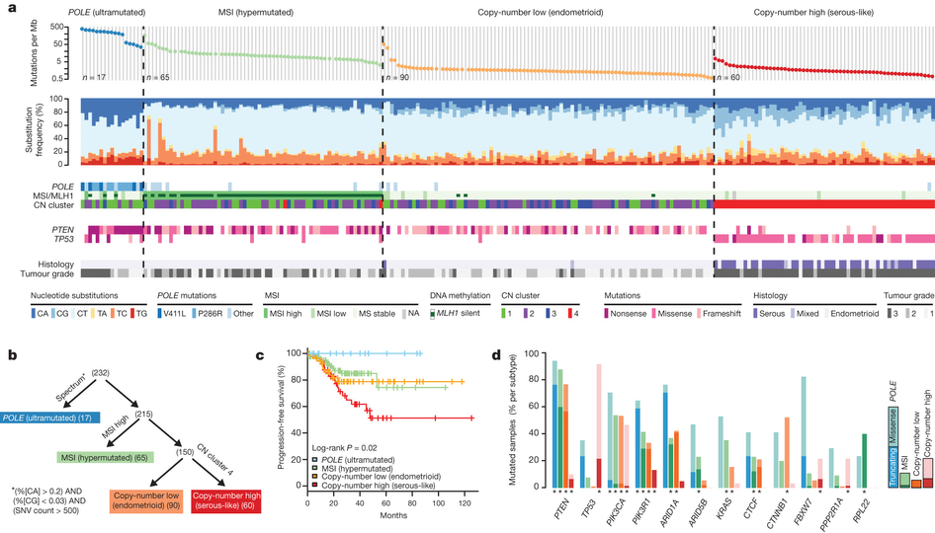
Exome sequence analysis
Integration of mutations + MSI + methylation + CNV

Slide 10
Group features
Cluster | 1 | 2 | 3 | 4
Histology | Endometrial | Endometrial | endometrial | Endometrial/Serous
Grade | 1 to 3 | 1 to 3 | 1 – 2 | 3
Mutation/Mb | 232e-6 | 18e-6 | 2.9e-6 | 2.3e-6
MSI | Low | High | Low | Low
CNV | Low | Low/inter | inter | High
Methylations |  | MLH1
Mutations | POLE - PTEN | PTEN | PTEN | TP53
232 samples

Slide 11
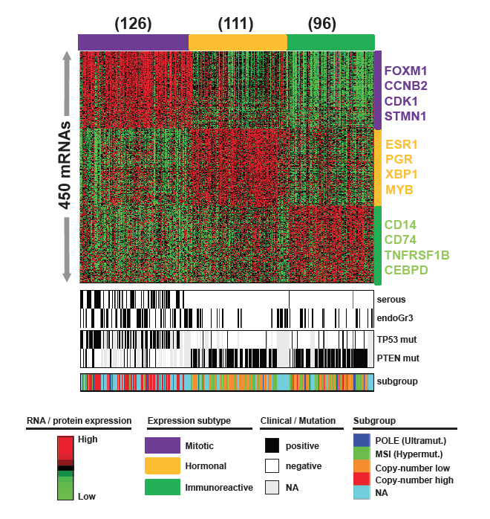
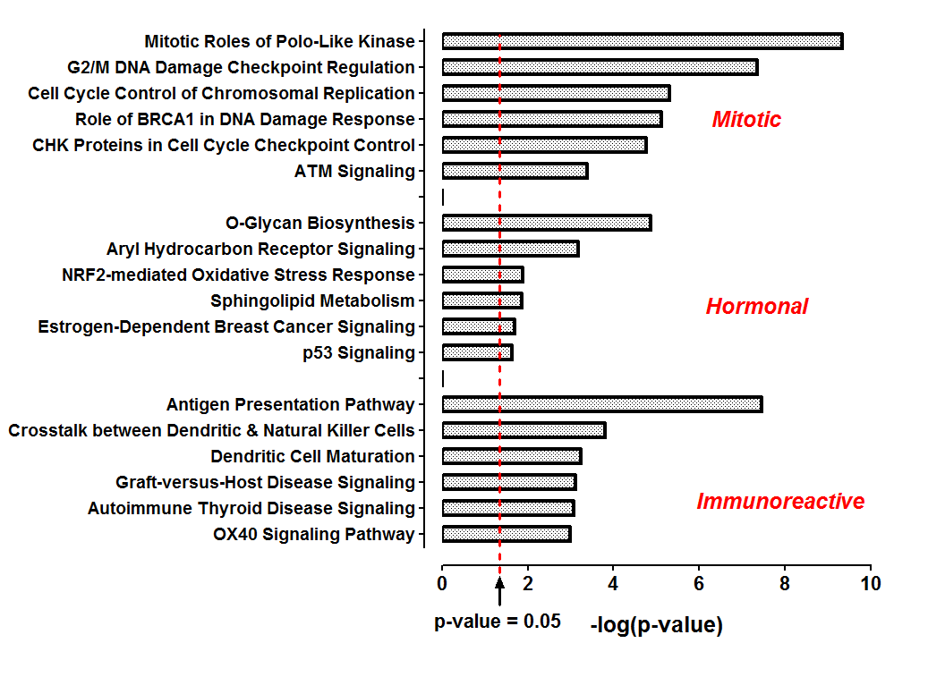
Multiplatform subtype classification
Unsupervised clustering on gene exprs.
Association with previously defined clusters: p < 1e-4

Slide 12
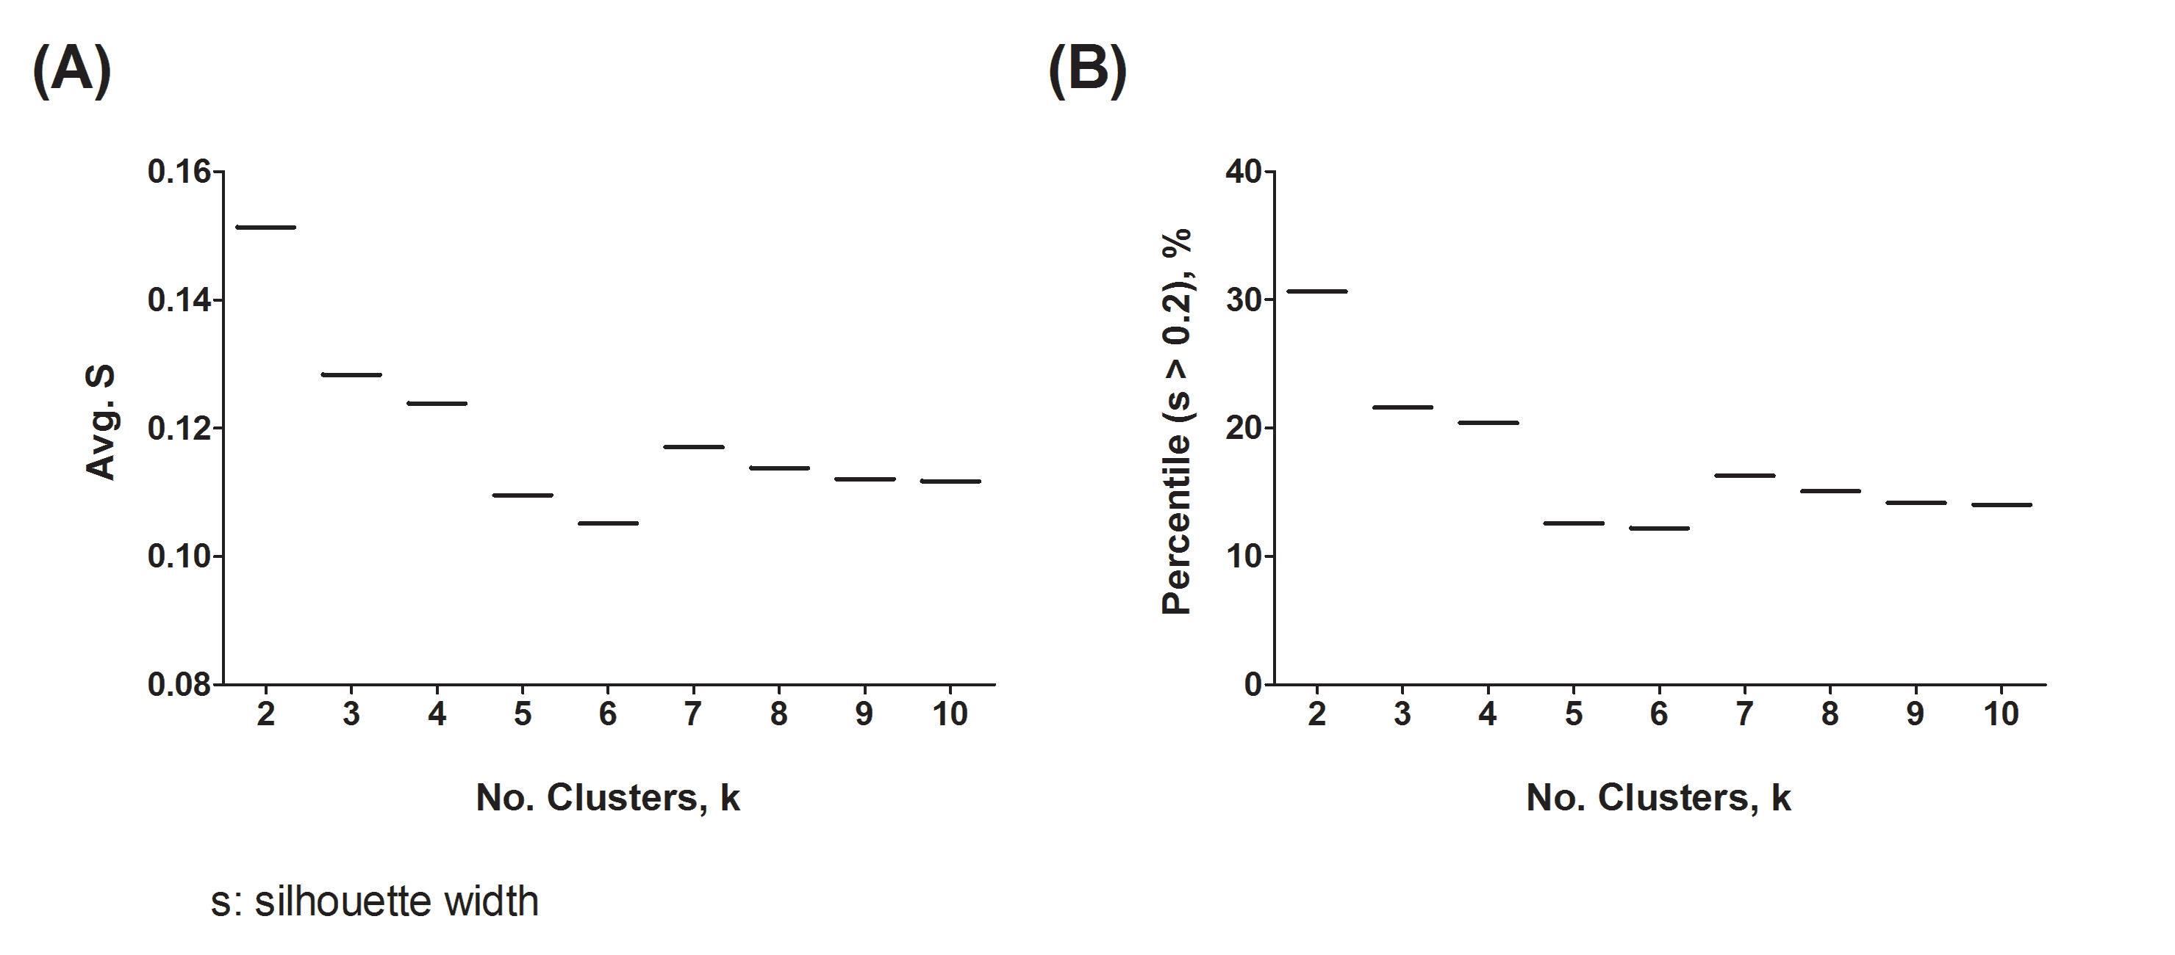
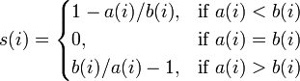
Silhouette clustering optimization
Histopathological classification
Chosen: k = 3
where

Slide 13
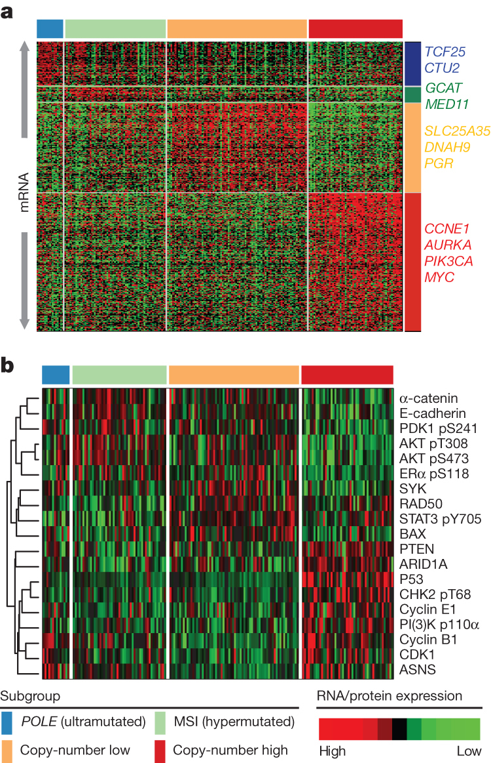
Supervised clustering
Gene exprs.
Proteins
 | Gene exprs. | Protein
POLE | Cell metabolism | High CCNB1
MSI | Decreased MLH1 | High pAKT, low PTEN
CNVlow | Increased PGR | Increased RAD50
CNVhigh | Cell cycle | Increased TP53

Slide 14
Translocations & Gene fusion strategy
discarded
Alignment against Ensembl 68 transcripts
Yes
No
discarded
Alignment against GRCh37 human ref genome
Yes
No
discarded
25bp both ends against GRCh37
Same gene
Different genes
38 genes fusions identified in individual samples
No clear impact on possible therapeutic decision
17 genes involved in recurrent translocations
Low frequencies: from 1 to 7 samples
No clear impact on possible therapeutic decision

Slide 15
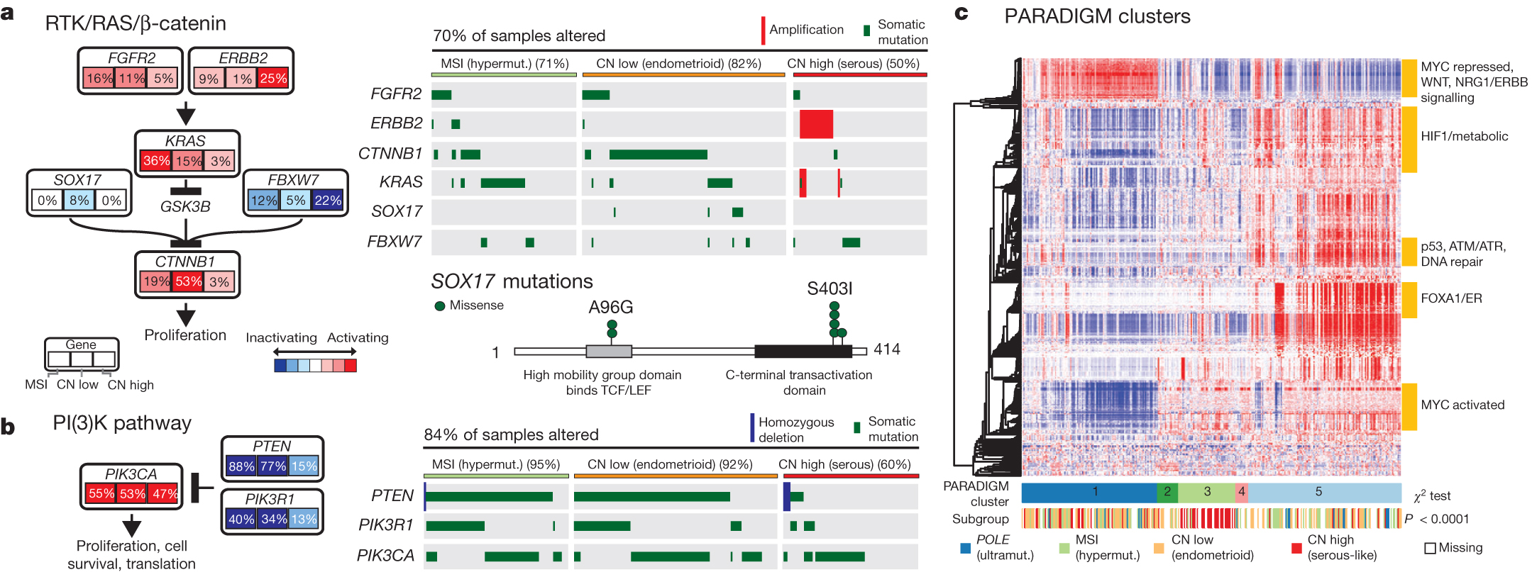
Pathway alterations
MEMo, excluding POLE group (n=17)
PARADIGM
5 clusters:
cluster1: WNT pathway
cluster3: CNVHigh + MYC/MAX signaling
cluster5: hormone receptors exprs.
CNVlow: mutations on CTNNB1 +SOX17 +/- (KRAS)
CNVhigh: ERBB2 amplification

Slide 16
Conclusion
Molecular-based classification of tumors
Integrated molecular patterns associated with survival (PFS)
POLE identified as a possible biomarker of good prognosis
CNV-driven management of endometrial tumors.
One sample re-reviewed and reclassified from serous to endometrioid grade 3
Identification of potential targets for molecular-driven therapeutic decision
- PGR exprs.
- CNV IGF1R focal amplification
ERBB2 (27%), FGF1, FGFR3 amplifications
LRP1B deletion
- Mutations PIK3CA (42%)
Unclear step-by-step strategy for data integration
Many results from different approaches, but hard to connect together.

